Slide 1
Key Management
Dr. B C Dhara
Department of Information Technology
Jadavpur University

Slide 2
Objectives
Explain the need for a key-distribution center (KDC)
Show how a KDC can create a session key
Show how two parties can use a symmetric-key agreement protocol to create a session key
Describe Kerberos as a KDC and an authentication protocol
Explain the need for certification authorities for public keys
Introduce the idea of Public-Key Infrastructure (PKI) and its duties
B C Dhara, Dept. of IT, JU

Slide 3
Introduction
We have studied symmetric-key and asymmetric-key cryptosystem
  How the secret keys in symmetric-key cryptography, public keys in asymmetric-key cryptography are distributed and maintained
B C Dhara, Dept. of IT, JU

Slide 4
SYMMETRIC-KEY DISTRIBUTION
Symmetric-key cryptography is more efficient than asymmetric-key cryptography for enciphering large messages
Symmetric-key cryptography, however, needs a shared secret key between two parties
The distribution of keys is another problem
B C Dhara, Dept. of IT, JU

Slide 5
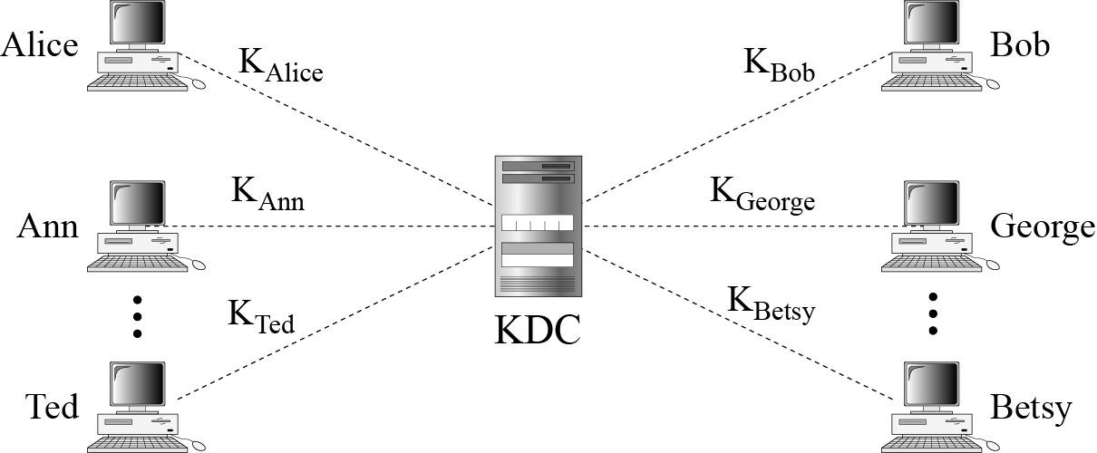
Key-Distribution Center: KDC
A practical solution to distribute the keys is the use of a trusted third party, referred as key-distribution centre (KDC)
B C Dhara, Dept. of IT, JU

Slide 6
How session key is created?
A secret key is established between KDC and each member
How two parties can send a confidential message between them?
  Sender (X) sends a request to the KDC for a session key between him and Y
  KDC informs Y about the X’s request
  If Y agrees, a session key is created between X and Y
  This session is used to authenticate X and Y to the KDC and prevent third party from impersonating
B C Dhara, Dept. of IT, JU

Slide 7
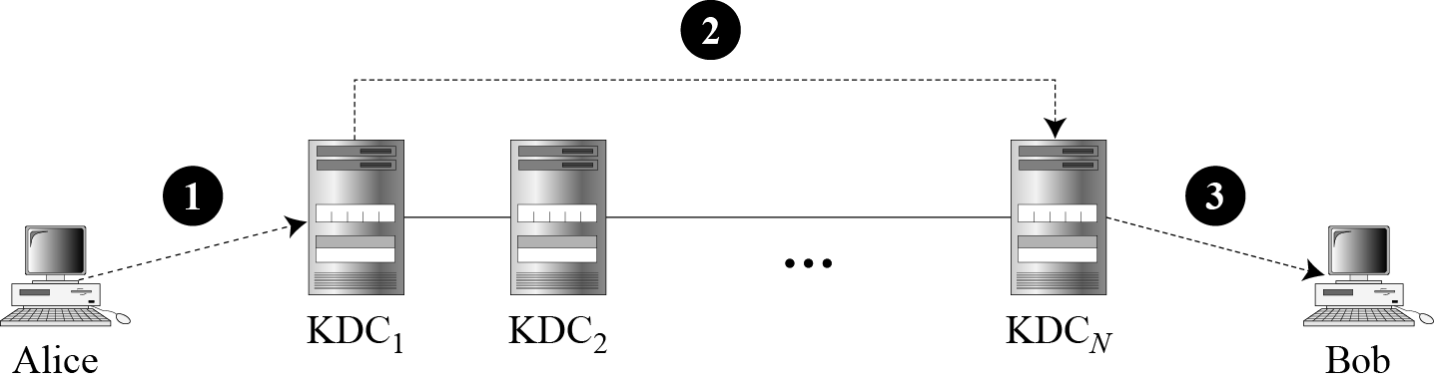
Flat Multiple KDCs
When number of people increases, a bottleneck situation may arises
  We need multiple KDCs
  Divide the world into domains
B C Dhara, Dept. of IT, JU

Slide 8

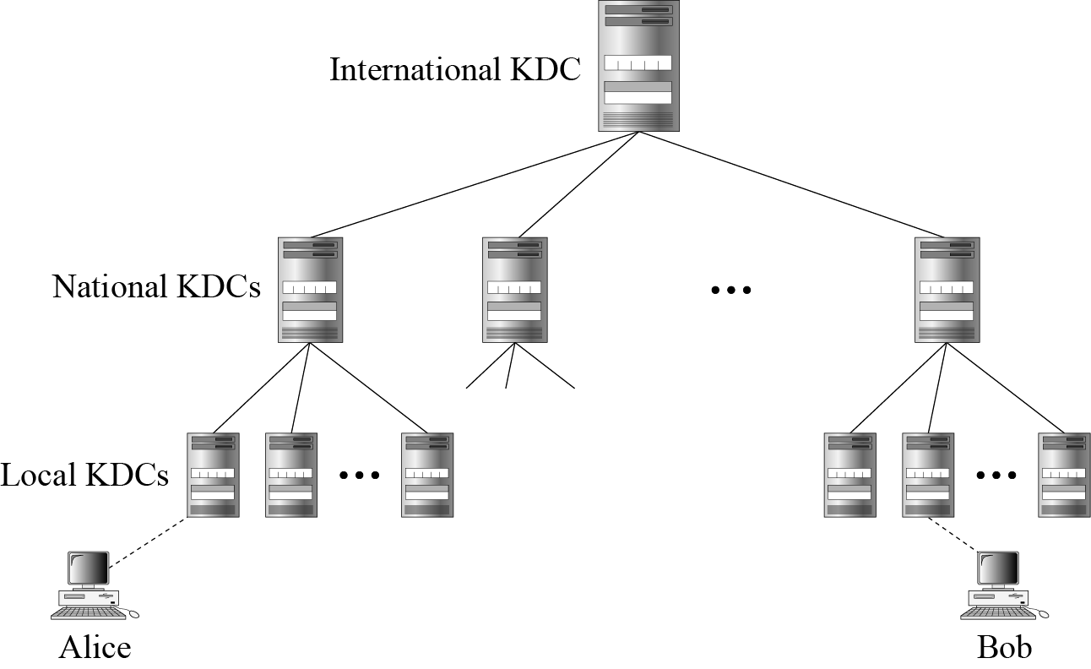
Hierarchical Multiple KDCs
B C Dhara, Dept. of IT, JU

Slide 9
Session Keys
A KDC creates a secret key for each member
This secret key can be used only between the member and the KDC, not between two members
  A session key is created , using their secret keys (between member and KDC)
  Members are authenticated by the secret key
  After communication is terminated, the session key is no longer useful
    A session symmetric key between two parties is used only once
B C Dhara, Dept. of IT, JU

Slide 10
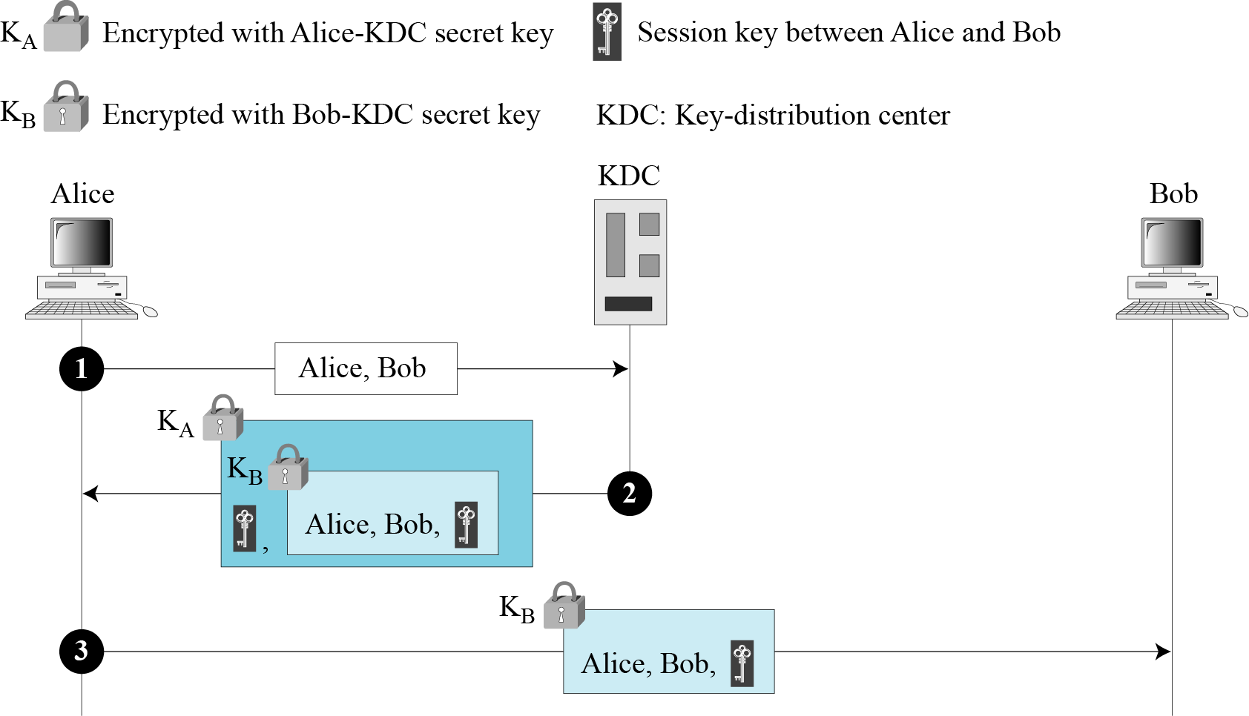
A Simple Protocol Using a KDC
This protocol has a flaw: attacker can use replay attack, save message in step 3 and replay it later
B C Dhara, Dept. of IT, JU
First approach using KDC

Slide 11
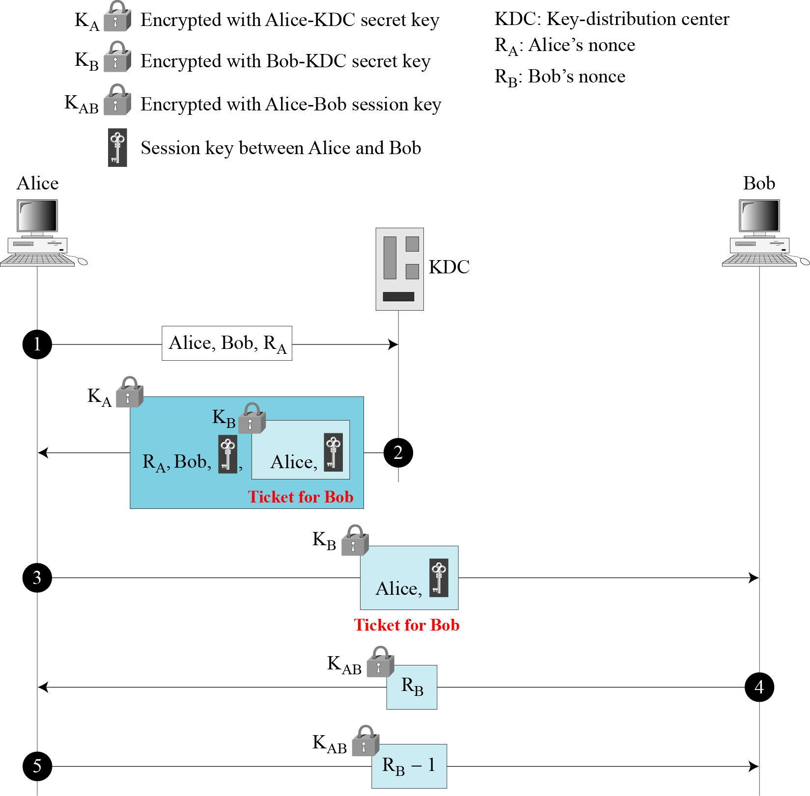
Needham-Schroeder Protocol
B C Dhara, Dept. of IT, JU

Slide 12
KERBEROS
Kerberos is an authentication protocol, and at the same time a KDC, that has become very popular
Several systems, including Windows 2000, use Kerberos. Originally designed at MIT, it has gone through several versions
B C Dhara, Dept. of IT, JU

Slide 13
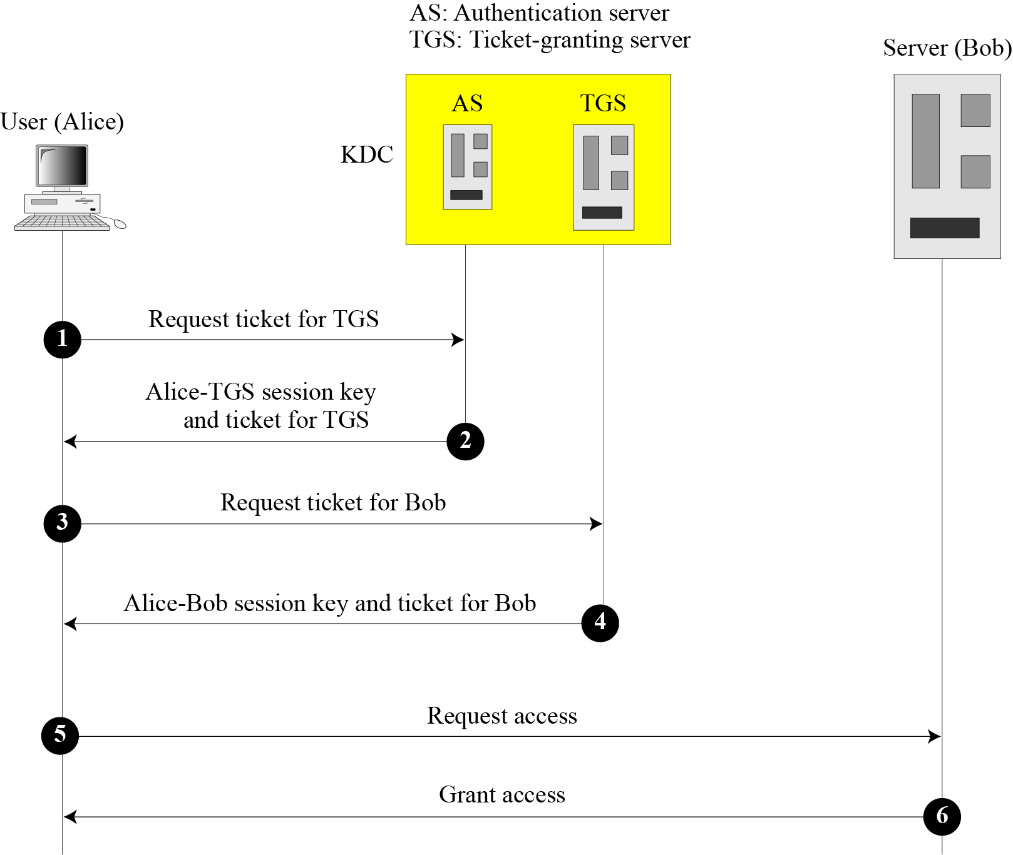
Kerberos (contd…)
Authentication Server (AS)” each user registers with AS and granted user id and password
In response of request from user:
issue session key between user-TGS and ticket for TGS , to access TGS
Three types of servers:
  Authentication server (AS)
  Ticket-granting server (TGS)
  Data (or real) server, to provide services to others
Ticket-Granting Server (TGS): issues a ticket for the real server (Bob).
Real Server: provides services for the user
B C Dhara, Dept. of IT, JU

Slide 14
SYMMETRIC-KEY AGREEMENT
When two parties create a session key between themselves without using a KDC. This method of session-key creation is referred to as the symmetric-key agreement
Diffie-Hellman Key Agreement
Station-to-Station Key Agreement
B C Dhara, Dept. of IT, JU

Slide 15
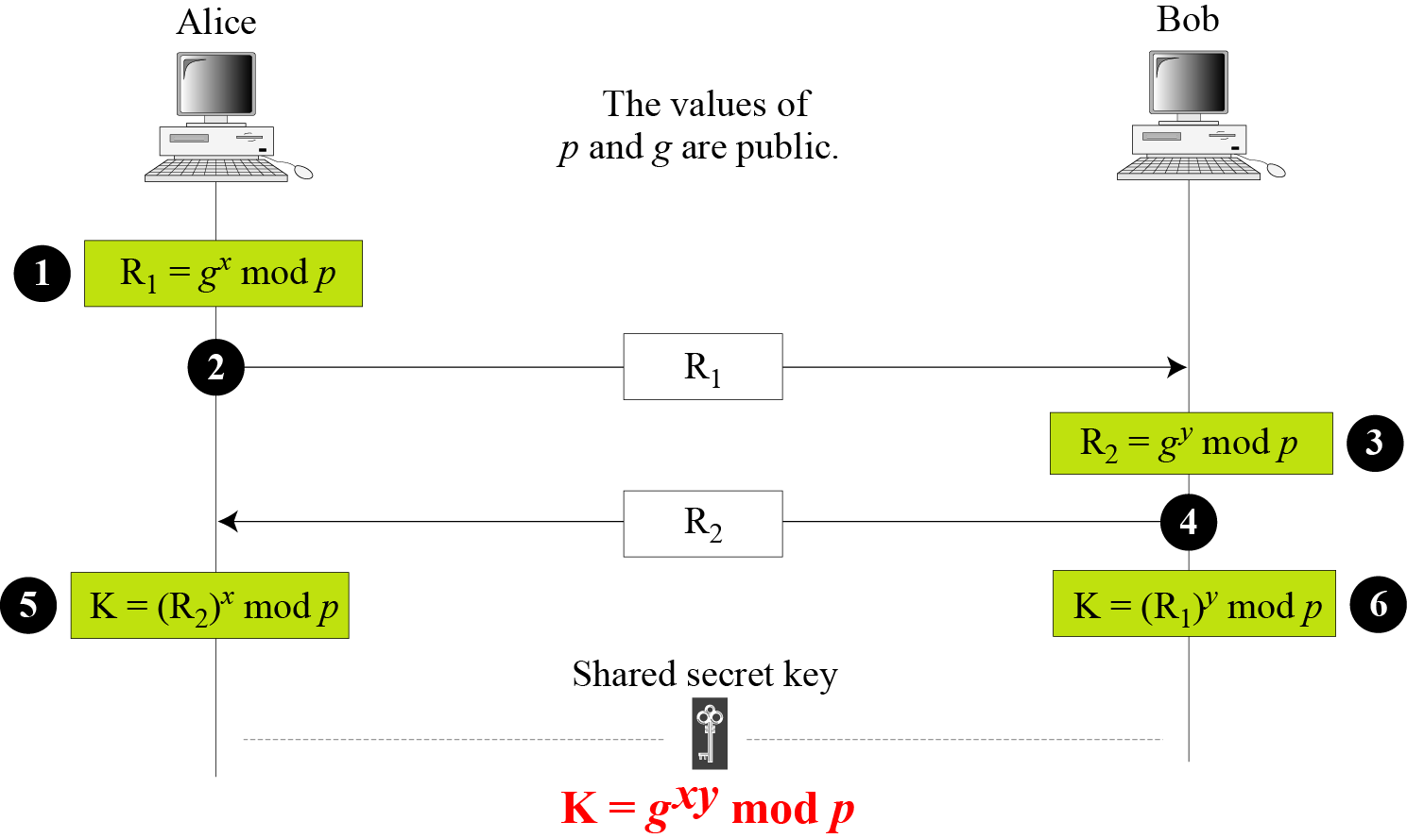
Diffie-Hellman Key Agreement
Two parties choose two number p and g: p is large prime number (with 300 digits), g is a generator of the group (Z_{p}*, ×)
Alice choose x, 0 ≤ x ≤ p-1
Bob choose y, 0 ≤ y ≤ p-1
B C Dhara, Dept. of IT, JU

Slide 16
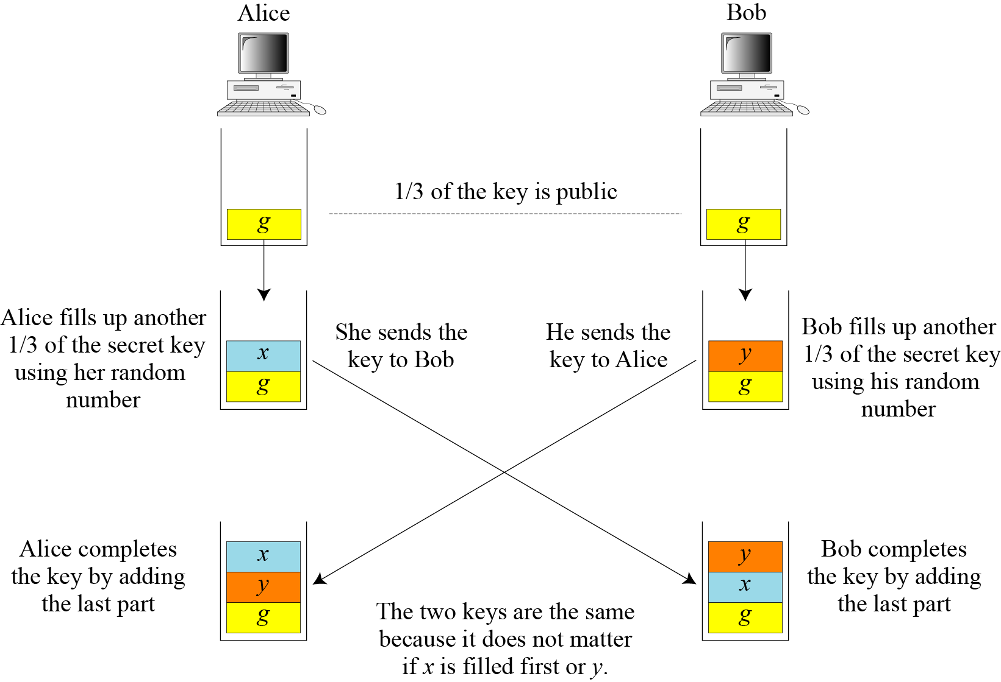
Analysis of Diffie-Hellman
Assume key with three parts: g, x, y
B C Dhara, Dept. of IT, JU

Slide 17
Security of Diffie-Hellman
This key exchange is susceptible to two attacks:
  Discrete logarithm attack
  Man-in-the-middle attack
B C Dhara, Dept. of IT, JU

Slide 18
Discrete Logarithm Attack
A third party can intercepts: R₁ and R₂
  If can find x from R₁=g^{x} mod p or
  y from R₂ = g^{y} mod p
  The key K= g^{xy} mod p is no more secure
To make Diffie-Hellman secure from discrete logarithm attack:
The prime p must be very large (more than 300 decimal digits)
Generator must be chosen from the group (Z_{p}*, ×)
Destroy x and y after the symmetric key is calculated
B C Dhara, Dept. of IT, JU
Different x and y must be used at different time instance

Slide 19
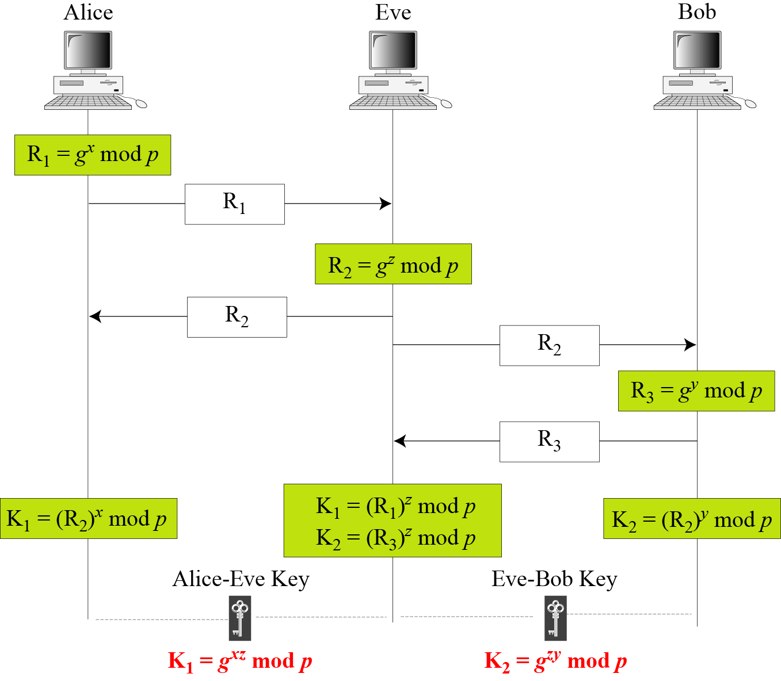
Man-in-the-middle Attack
Attacker does not have to find x and y
Attacker creates two keys:
one between himself and Alice and other one between himself and Bob
B C Dhara, Dept. of IT, JU

Slide 20
PUBLIC-KEY DISTRIBUTION
In asymmetric-key cryptography, people do not need to know a symmetric shared key; everyone shields a private key and advertises a public key.
How the public key can be distributed?
  Public Announcement
  Trusted Center
  Controlled Trusted Center
  Certification Authority
  X.509
  Public-Key Infrastructures (PKI)
B C Dhara, Dept. of IT, JU

Slide 21
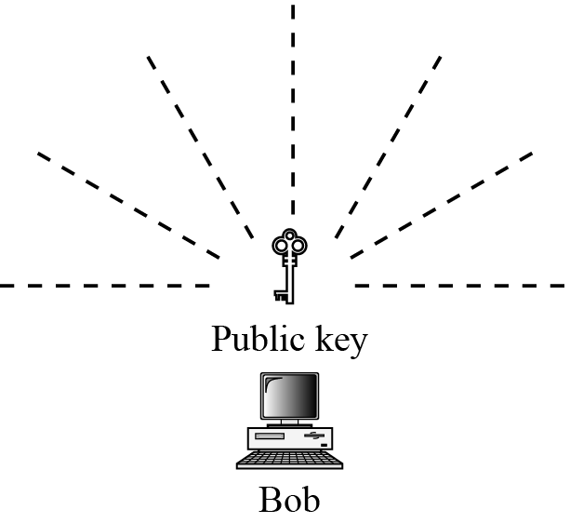
Public Announcement
Announce public keys publicly
  Put public key on website
  Announce in a local/national newspaper
  This approach is not secure, it is subject to forgery
    Eve could make such a public announcement (before step from Bob, damage could be done)
    If Alice directly requests Bob
      Eve can intercept Bob’s response and substitute her own public key
B C Dhara, Dept. of IT, JU

Slide 22
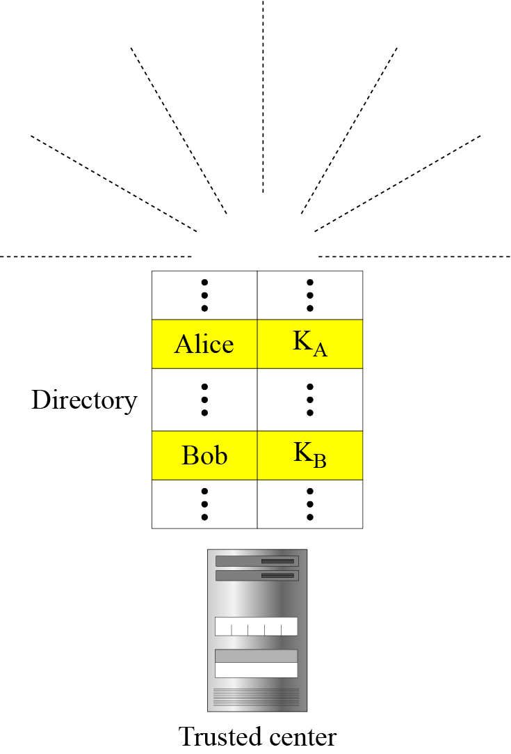
Trusted Center
There is a directory of public keys
  Which is dynamically updated
Each user has to register in the center
  Gets an identity
Each user fix a private key and public key
  Keep the private key and public key is stored into the directory
The directory can be publicly advertise by the trusted center
B C Dhara, Dept. of IT, JU

Slide 23
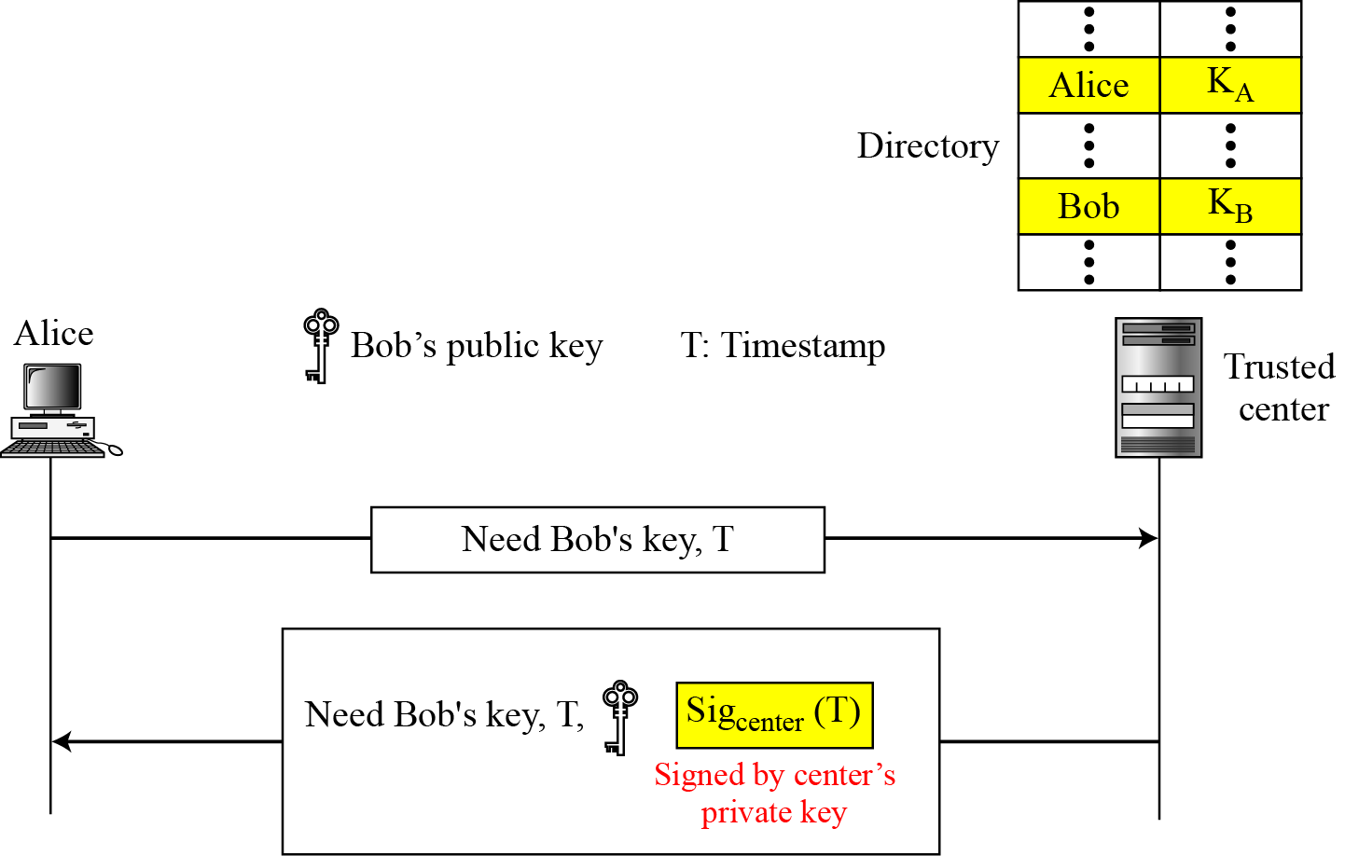
Controlled Trusted Center
Higher level of security can be achieved if additional controls added on the distribution of the public key
Announcement of public-key includes a timestamp and a signature of authority
  Prevents interception and modification of the response
B C Dhara, Dept. of IT, JU

